Slide 1
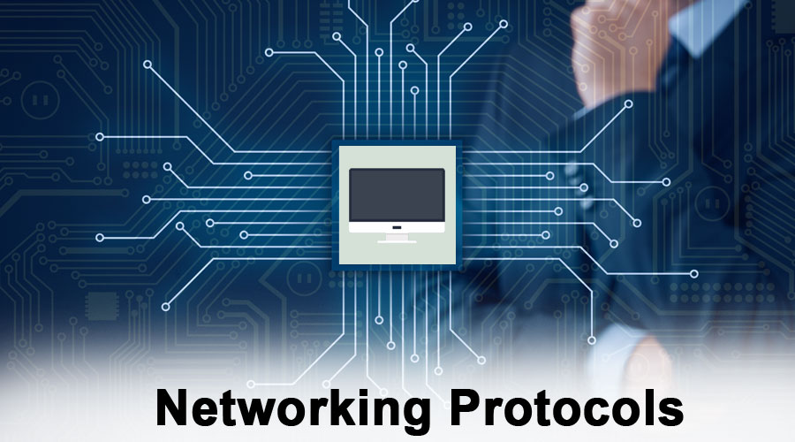
NETWORK PROTOCOLS

Slide 2
TABLE OF CONTENT
WHAT IS NETWORK PROTOCOL?
TCP/IP MODEL
IP(Internet protocol)
FTP(file transfer protocol)
PPP(Point to point protocol)
HTTP(Hyper text transfer protocol) SMTP(Simple mail transfer protocol)
Pop3(post office protocol)

Slide 3
WHAT IS NETWORK PROTOCOL?
A Network protocol is established set of rules that determine how data is transmitted between different devices in the same network.

Slide 4
TCP/IP
TCP/IP ,or the Transmission control protocol/Internet Protocol , is a suits of communication protocols used to interrconnect network devices on the internet.
APPLICATION
TRANSPORT
INTERNET
LINK
LAYER 4
LAYER 3
LAYER 2
LAYER 1

Slide 5
IP(Internet protocol)
Each computer has unique address over internet , is called IP address . An IP address is an identifier for a computer or devices on a TCP/IP network .

Slide 6
FTP(File Transfer Protocol)
The FTP is a standard network protocol used for the transfer of computer files between a client and server on a computer network.
FTP is built on a client –server model architecture.

Slide 7
PPP(Point to Point Protocol)
In computer networking , point to point protocol is a data link layer communication protocol between two router directly without any host or any other networking in between.

Slide 8
HTTP(Hyper Text Transfer Protocol)
HTTP is a protocol which allows the fetching of resources, such as HTML document .
It is the foundation of any data exchange on the web and it is a client –server protocol , which request are initiated by the recipient , usually the web browser.

Slide 9
SMTP (Simple Mail Transfer Protocol)
The simple mail transfer protocol is a communication protocol for electronic mail transmission.

Slide 10
POP3 (Post Office Protocol)
The POP is an application –layer Internet standard protocol used by email client to retrieve e-mail from a mail sever.
POP3 download the email from a server to a single computer , then deletes the email from the server.

Slide 11
THANK YOU

